Slide 1
Linear regression
Borce, Ron Ken S.

Slide 2
Introduction

Slide 3
Concept & definition
Linear Regression predicts a continuous value by fitting a straight line between input(s) and output.
a method used to model the relationship between two variables by fitting a straight line through data points to make predictions.

Slide 4
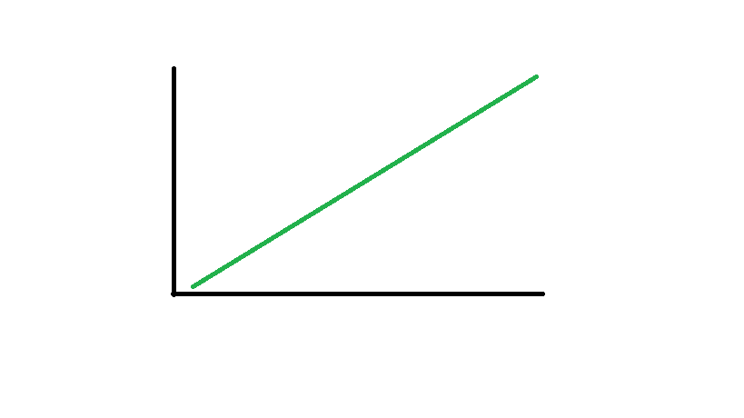
How it works?
Diagram
1500 Pesos
1000 Pesos
500
Pesos
20 Grams
40 Grams
60 Grams

Slide 5
Real-world application & Implementation
Predicting house prices
Salary vs. experience
Red wine quality predictor

Slide 6
Coding implementation
Study hours & exam score

Slide 7
Research trends
“Healthcare Predictive Analytics using Machine Learning”
This paper explores how linear regression, alongside other machine learning models, is used to predict healthcare outcomes such as disease risk, treatment effectiveness, and hospital readmission rates.
Highlights:
Linear regression is used for modeling relationships between patient features (age, symptoms, lab results) and outcomes (e.g., diabetes risk).
Compared with other models like decision trees and neural networks, linear regression offers interpretability and low computational cost.
The study emphasizes data preprocessing (normalization, feature selection) as critical for improving prediction accuracy.

Slide 8
Reflection
Linear regression remains one of the most powerful and accessible tools in data science, statistics, and everyday decision-making. In today’s world, where data drives industries, policies, and personal choices, understanding how variables relate is essential.

Slide 9
references
https://mljourney.com/linear-regression-real-life-examples/
https://www.statisticalaid.com/linear-regression/#google_vignette
https://researchmate.net/linear-regression/
https://wbuhs.ac.in/wp-content/uploads/2020/10/7.-Original-Article-Shahnewaz.pdf

Slide 10
THANK YOU

